Slide 1


Slice and Dice: Course Introduction
S'n'D Course Program, Evaluation, Exams, Resources
Doncho Minkov
Technical Trainer
http://minkov.it
Telerik Software Academy
academy.telerik.com

Slide 2

Table of Contents
The Slice and Dice Course Program
Exams and Evaluation
Standard Criteria
Bonuses
Resources for the Course

Slide 3

Slice and Dice
Coming to the start of Web Development

Slide 4

What's Coming Next?
Slice and Dice
Continuation of CSS Styling
Fundamentals of Web development
Pretty much the same
Lectures once a week
Practical exam after a month and half
The course exam?
Slicing a PSD design to HTML and CSS

Slide 5

Slice and Dice - Program
What Will We Cover in the Course?

Slide 6


Slice and Dice - Course Program
Slice and Dice Course Intro
Course Program, Exams, Evaluation
Intro to WordPress theming
What is WordPress
How to make themes for WordPress
Presentation for the WP User Group

Slide 7
Slice and Dice - Course Program (2)
Responsive Design and Media Queries
Responsive Design paradigms
Media queries
Implementing responsive design
Responsive design everywhere
Photoshop for Slicing
Layers
Identifying elements
Images, etc…

Slide 8
Slice and Dice - Course Program (3)
Slice and Dice - Workshop
Creating a web site by given PSD design
Creating Web pages everywhere
Making a page work on most browsers
Feature detection
HTML 5 Modernizr
SVG for gradients

Slide 9
Slice and Dice - Course Program (4)
Slice and Dice - everywhere
Creating a responsive Web site from given PSD
Working on most browsers
Web Performance
Minifying JavaScript and CSS
Sprites
CDNs
Developing a Web site by given PSD
Exam preparation

Slide 10





Evaluation
Thank God There Are Bonuses!

Slide 11

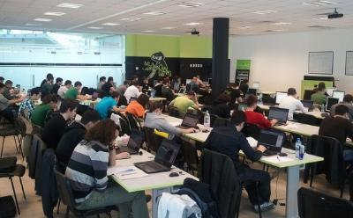
Slice and Dice– Evaluation
Evaluation components
Practical project – 60%
Homework – 15%
Homework evaluation – 15%
3 peer reviews per homework
Attendance in class – 10%
Bonuses
Forums activity – bonus up to 15%
Helping the other students – bonus up to 15%
PC Magazine contest – bonus up to 20%

Slide 12








Resources
What We Need in Addition to this Course Content?

Slide 13
Slice and Dice - Resources
The usual suspects:
Mozilla Development Network (MDN)
https://developer.mozilla.org
Mostly used for the presentations
Web Platform
http://www.webplatform.org
The place where all masters contribute
Adobe, Apple, Facebook, Google, HP, Intel, Microsoft, Mozilla, Nokia, Opera, W3C

Slide 14
Course Web Site & Forums
Register for the "Telerik Academy Forums":
Discuss the course exercises with your colleagues
Find solutions for the exercises
Share source code / discuss ideas
The Slice and Dice official web site:
forums.academy.telerik.com/web-design-with-html5-css-and-javascript
http://academy.telerik.com/student-courses/web-design-and-ui/slice-n-dice

Slide 15
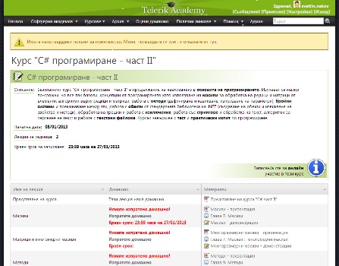
Telerik Integrated Learning System (TILS)
The Telerik Integrated Learning System (TILS)
www.telerikacademy.com
Important resource for all students
Homework submissions
Homework peer reviews
Presence cards with barcode
Reports about your results
telerikacademy.com/Courses/Courses/Details/34

Slide 16



Required Software
Software needed for this course:
Microsoft Visual Studio 2012 or Visual Studio Express 2012 (free version of VS 2012)
Sublime Text
Komodo IDE
Notepad ++
Brackets

Slide 17



Slice and Dice Introduction
http://academy.telerik.com

Slide 18



Free Trainings @ Telerik Academy
Web Design and UI Technologies @ Telerik Academy
html5course.telerik.com
Telerik Software Academy
academy.telerik.com
Telerik Academy @ Facebook
facebook.com/TelerikAcademy
Telerik Software Academy Forums
forums.academy.telerik.com

